Slide 1

CROP YIELD PREDICTION & COMPARISON USING MACHINE LEARNING & DEEP LEARNING TECHNIQUES. By: Sukriti Nijhawan (189303114) & Sanchit Jain (189302008) Project Guide: Ms. Kavita Jhajharia

Slide 2
01 Introduction
02 Project Aim
03 Dataset
04 Data Analysis
05 Models and Performance
06 Result Analysis
07 Conclusion
Table of
Contents

Slide 3
1. Introduction
Learning about the motivation behind our project.

Slide 4
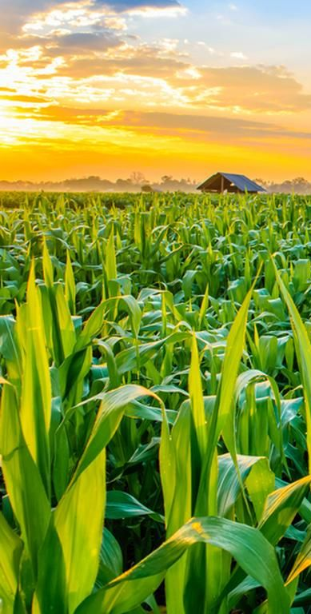
It's not for nothing that the science of teaching machines to learn and generate models for future predictions is commonly used. Agriculture is extremely important to the global economy. Understanding global crop yield is critical for resolving food security issues and mitigating the effects of climate change as the human population continues to grow.
Crop yield forecasting is a significant agricultural problem. Weather conditions (rain, temperature, etc.) and pesticides have a great impact on agricultural yield. It is important to have accurate knowledge about crop yield history while making decisions about agricultural risk management and forecasting the future.

Slide 5
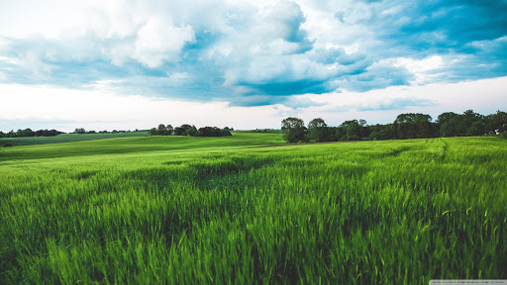
Machine learning is a useful decision-making method for predicting crop yields, as well as for deciding which crops to plant and what to do during the crop's growing season. To aid crop yield prediction study, a number of machine learning models have been used. Deep learning models have also been recently used for crop yield prediction.

Slide 6
2. Project Aim
The objectives of our project.

Slide 7
In this project, we compare and predict the yield of five crops (wheat, barley, jowar, rapeseed & mustard, and bajra) in Rajasthan (district-wise) using three machine learning techniques: random forest, lasso regression and SVM, and two deep learning techniques: gradient descent and RNN LSTM.
To apply the models to our data, we divided it into training and testing datasets. Each model is tested twice: once with only "area" and "production" in mind, and then again with additional factors (rainfall and soil type) in mind to predict crop yield.
To find the model that most accurately predicts the yield, R2 score, Root Mean Squared Error (RMSE) and Mean Average Error (MAE) are calculated for each model.

Slide 8
3. Dataset
Initial Dataset, Feature Expansion, Data Preprocessing

Slide 9
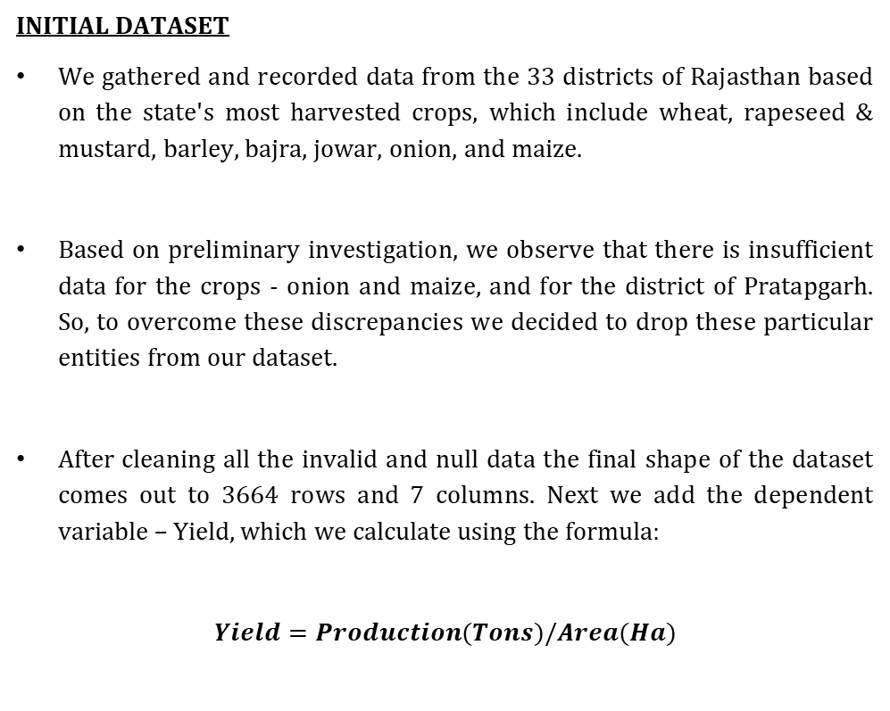
INITIAL DATASET
We gathered and recorded data from the 33 districts of Rajasthan based on the state's most harvested crops, which include wheat, rapeseed & mustard, barley, bajra, jowar, onion, and maize.
Based on preliminary investigation, we observe that there is insufficient data for the crops - onion and maize, and for the district of Pratapgarh. So, to overcome these discrepancies we decided to drop these particular entities from our dataset.
After cleaning all the invalid and null data the final shape of the dataset comes out to 3664 rows and 7 columns. Next we add the dependent variable – Yield, which we calculate using the formula:
$$Yield=Production(Tons)/Area(Ha)$$

Slide 10
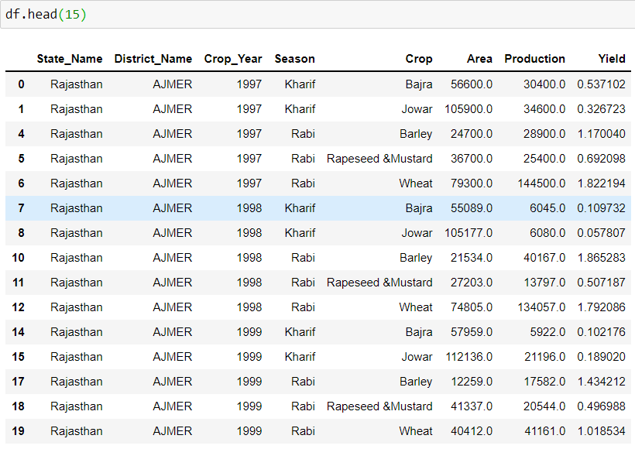
Figure: Dataset for analysis.

Slide 11
FEATURE EXPANSION
In order to get a more scientific result, we added a few more independent features to our dataset, which are: the soil type of that particular district and the amount of rainfall received over the years in these districts.
Each district has its specific combination of soil, which is in the form of categorical data. So, for us to perform prediction over the dataset, we encode them and hence create dummy variables.
For crops that are produced during the Kharif season, we take into account the rainfall received during the months of July, August, September, and October, while for Rabi season we take the mean of the rainfall received during November, December, January, February, and March.

Slide 12
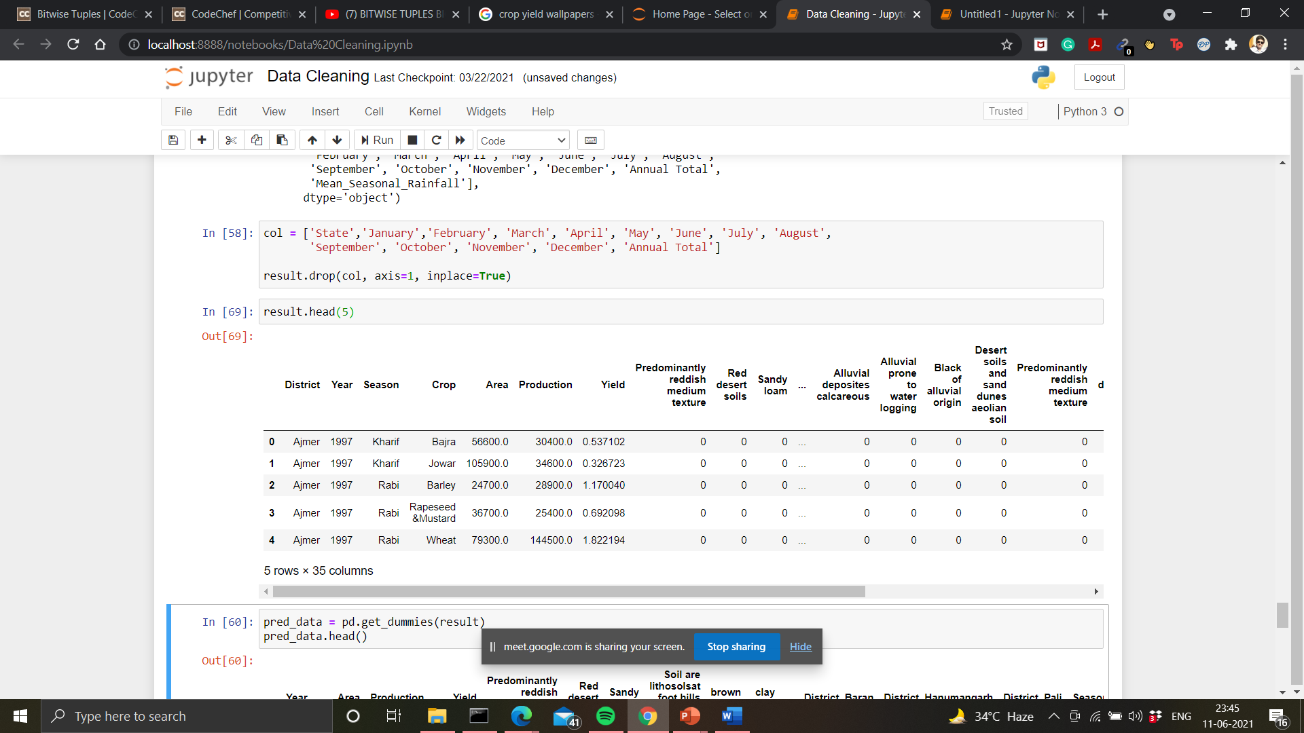
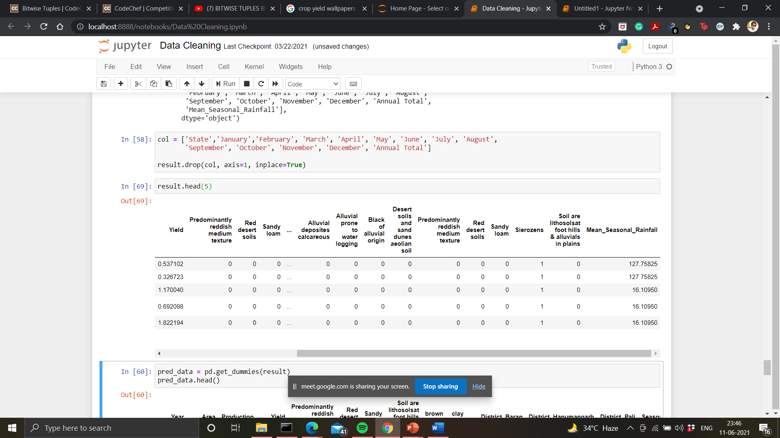
Figure(s): Final Dataset for analysis.

Slide 13
DATA PREPROCESSING
In order to perform predictive analysis on our dataset, encoding of categorical variables is required, for which we chose the method of creating dummy variables which provided us with more flexibility for our models.
In order to standardize our data we used the StandardScaler() measure present in the SciKitLearn library and later we split the data accordingly into training and testing datasets.

Slide 14
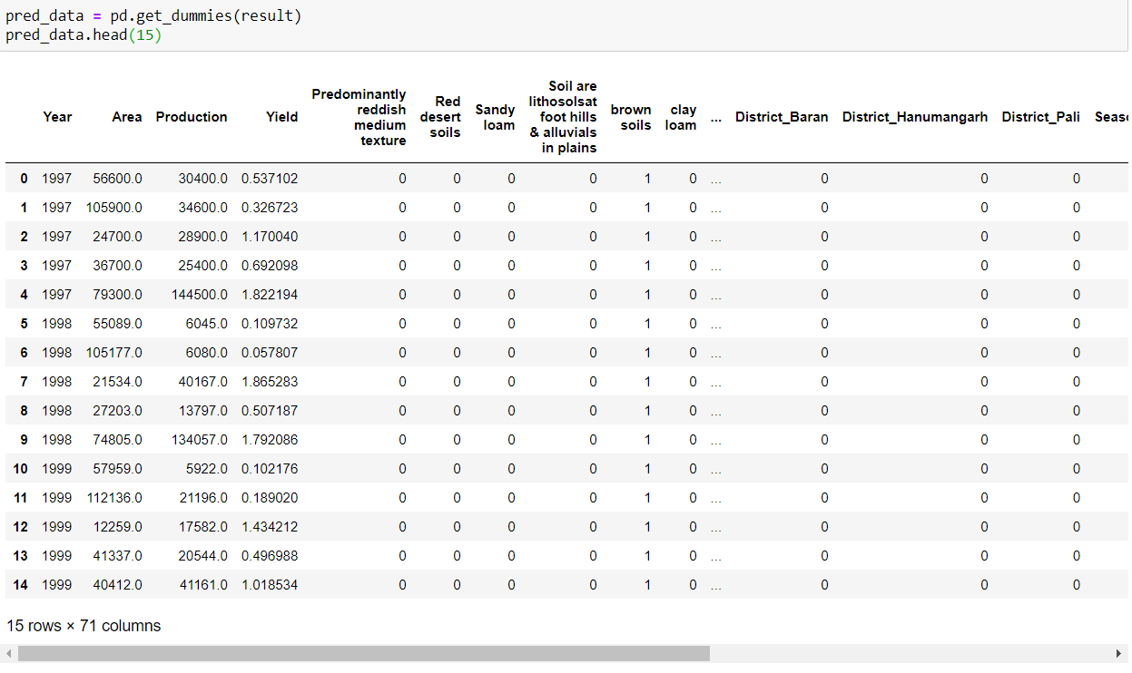
Figure: Dataset for predictive analysis.

Slide 15
4. Data Analysis
Rainfall vs Year, for each crop Area vs Year and Yield vs Year have been used for analysis.

Slide 16

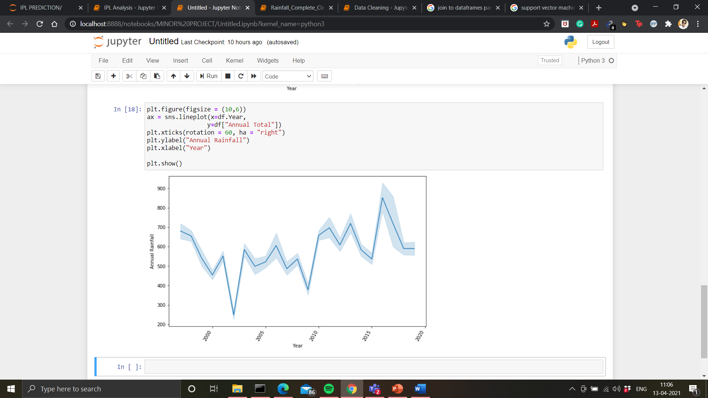
Figure: Annual rainfall vs. Year

Slide 17
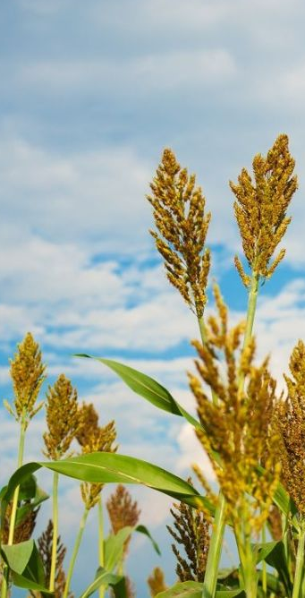
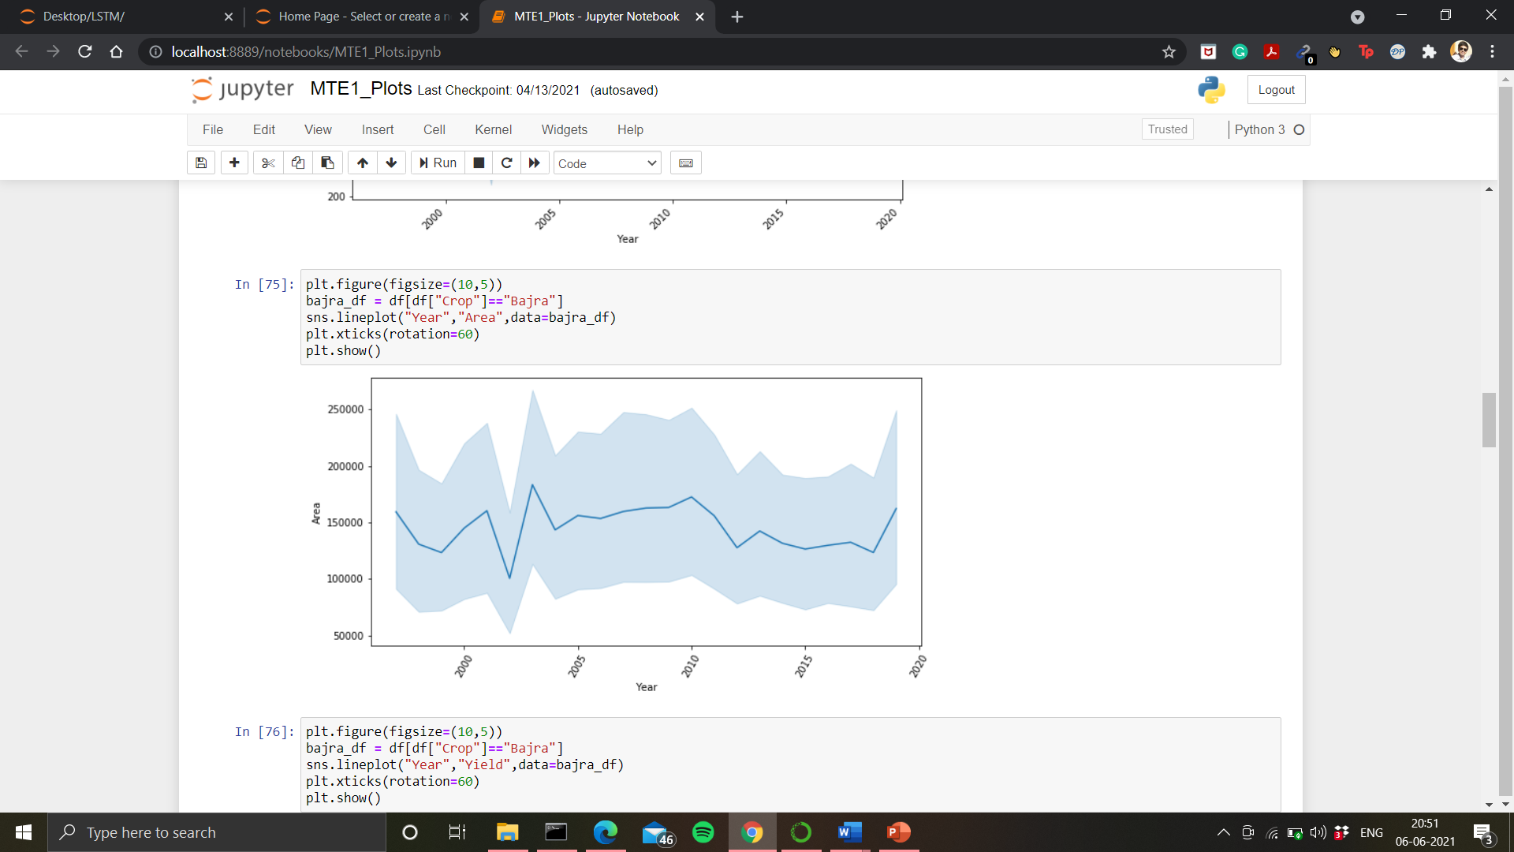
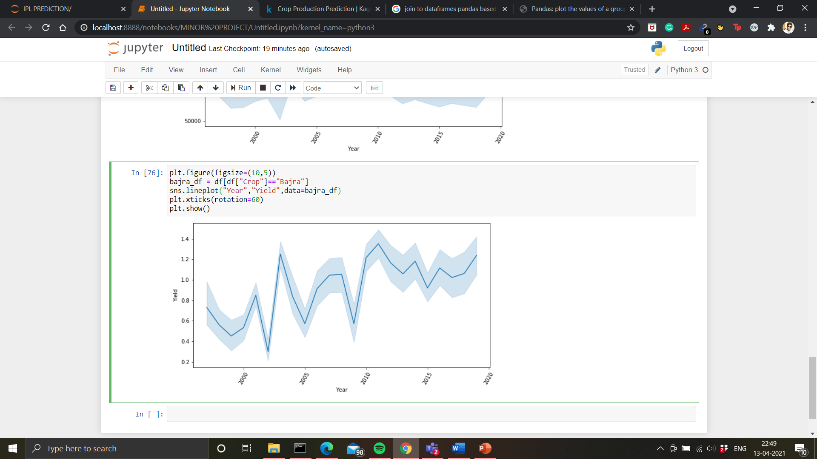
Figure: Area under irrigation vs Year (Bajra)
Figure: Yield vs Year (Bajra)

Slide 18
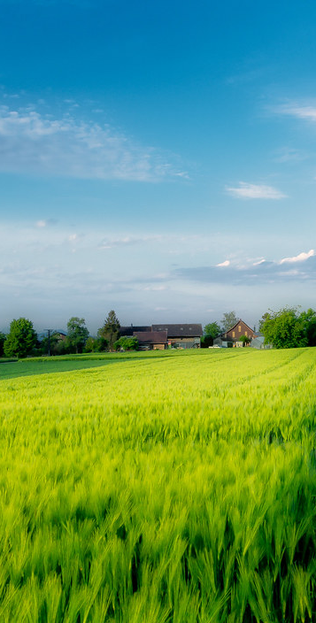
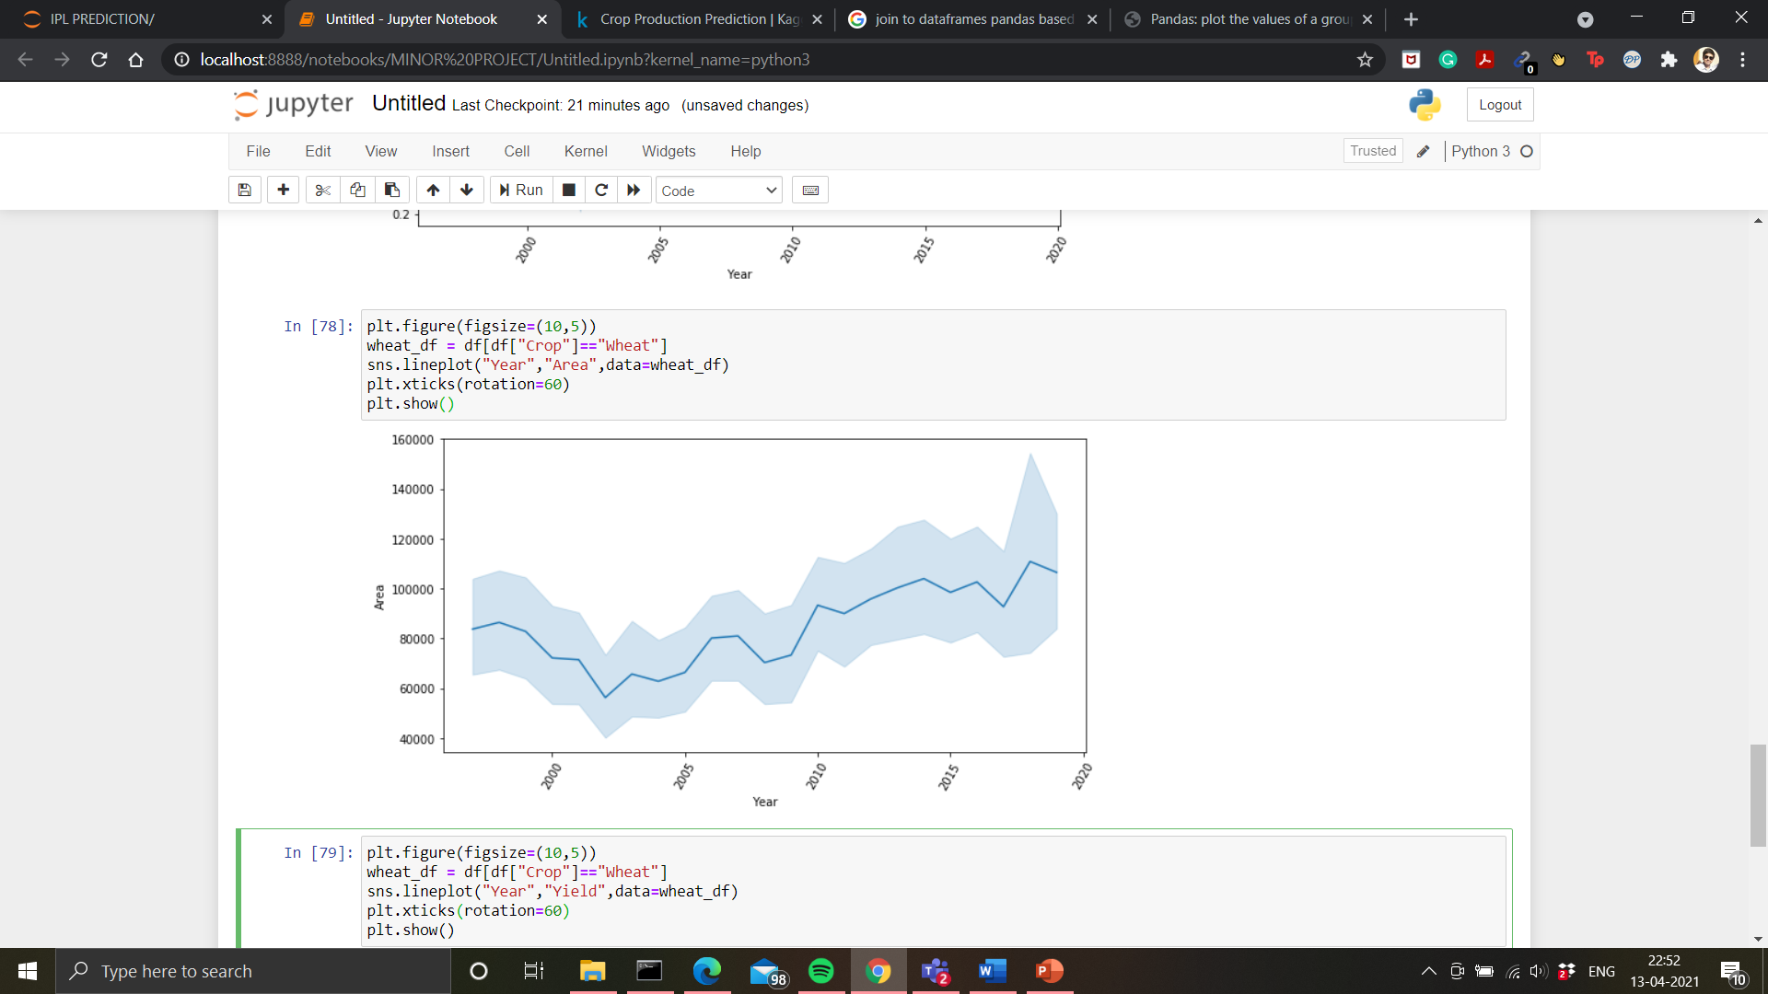
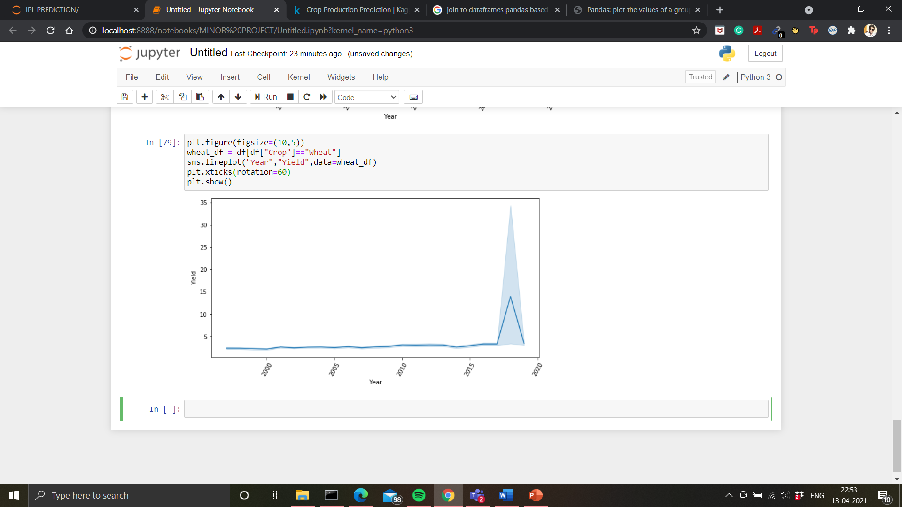
Figure: Area under irrigation vs. Year (Wheat)
Figure: Yield vs Year (Wheat)

Slide 19
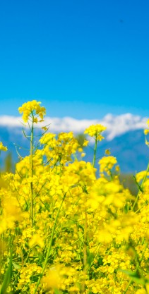
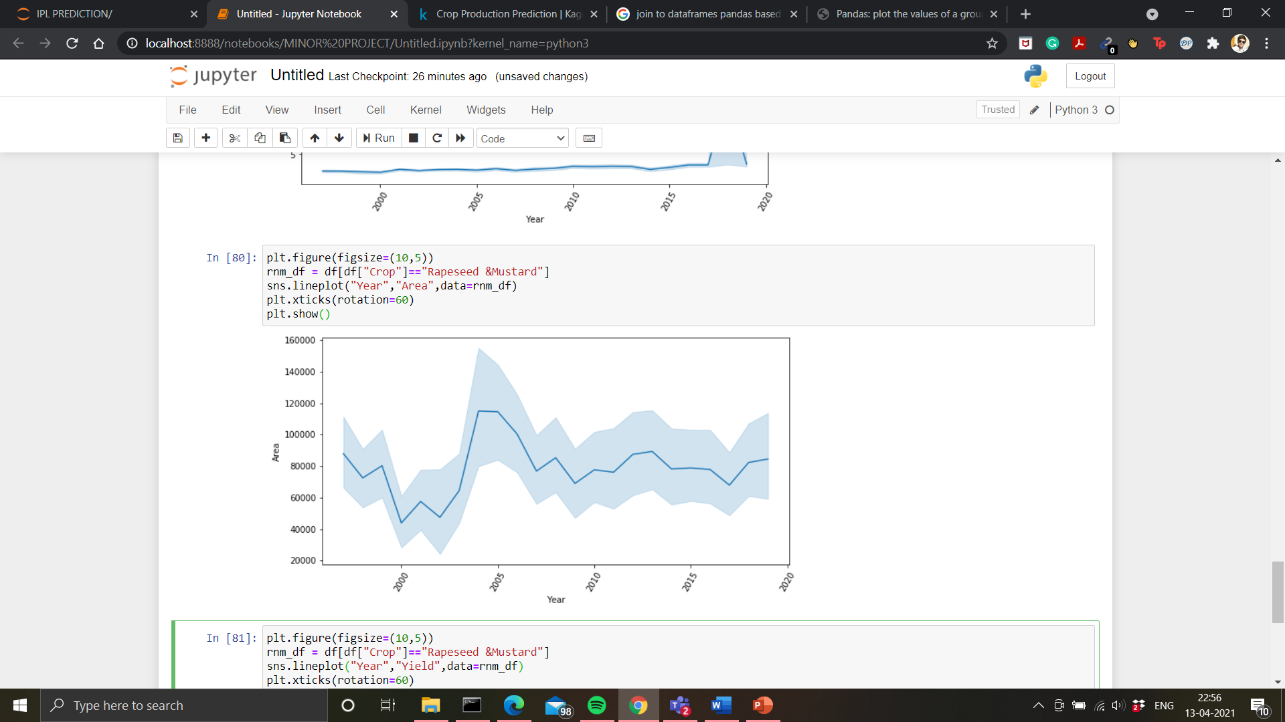
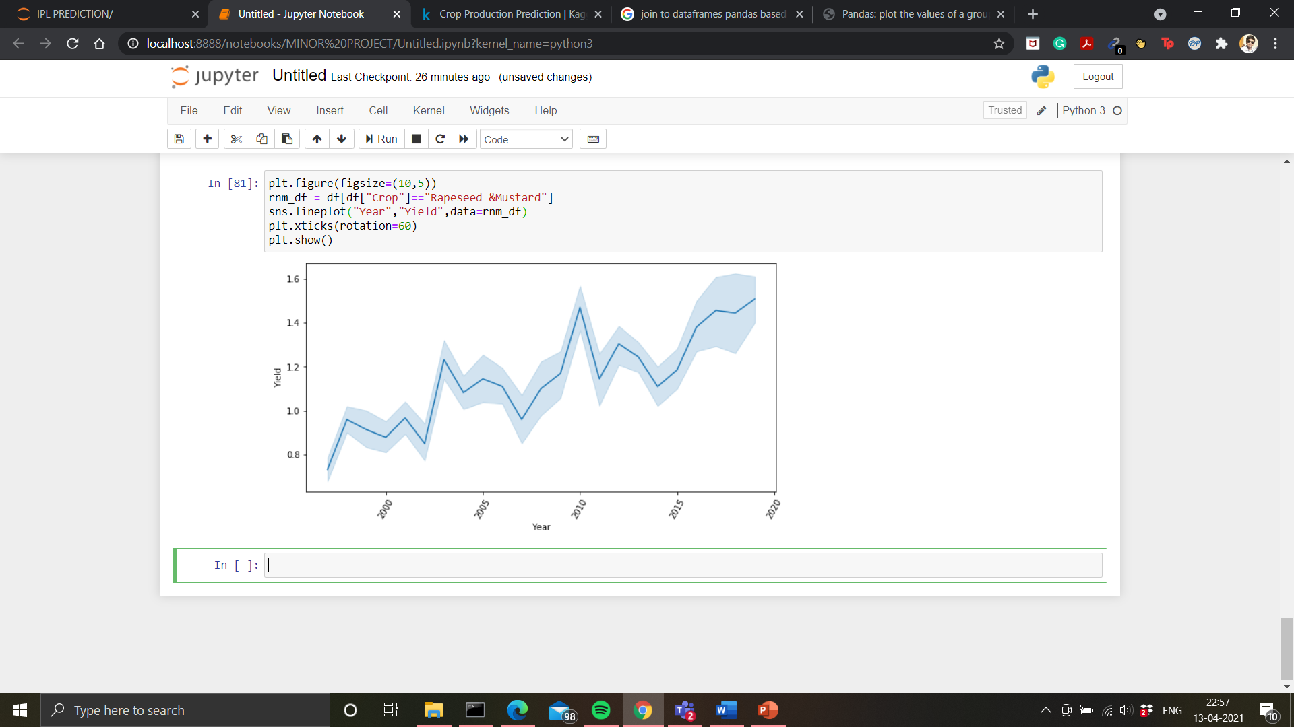
Figure: Area under irrigation vs Year (Rapeseed & Mustard)
Figure: Yield vs Year (Rapeseed & Mustard)

Slide 20
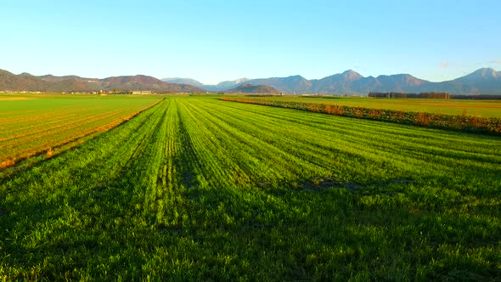
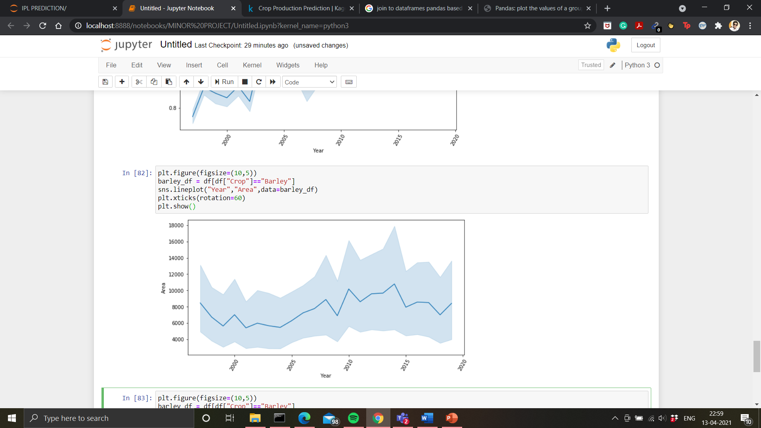
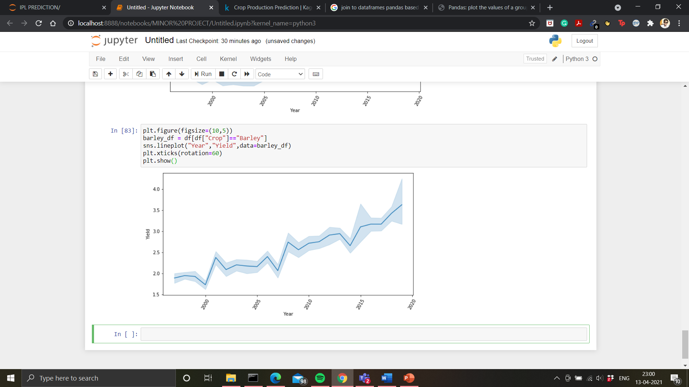
Figure: Area under irrigation vs Year (Barley)
Figure: Yield vs Year (Barley)

Slide 21
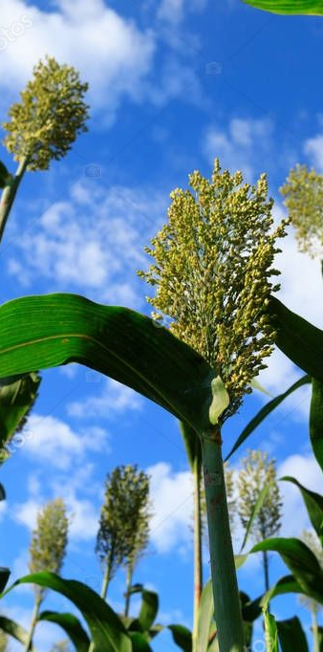
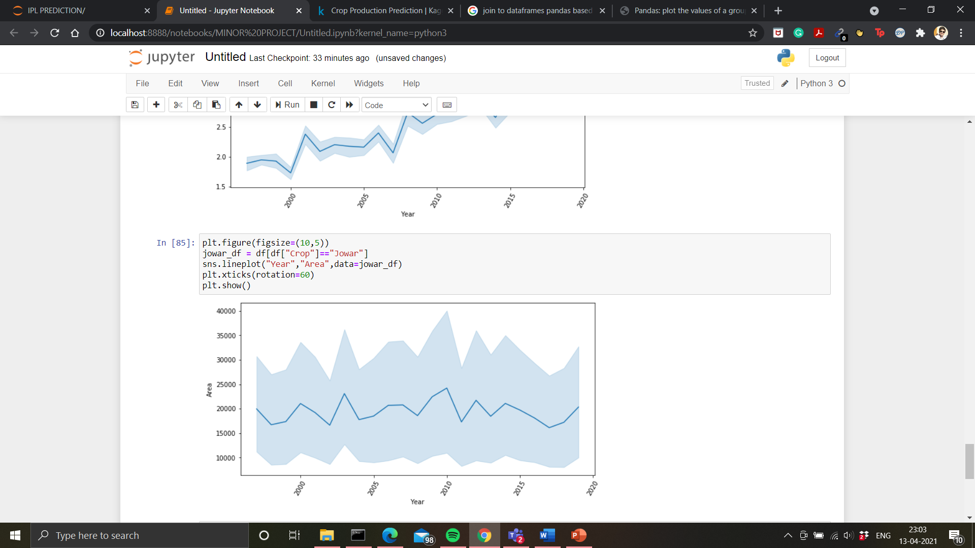
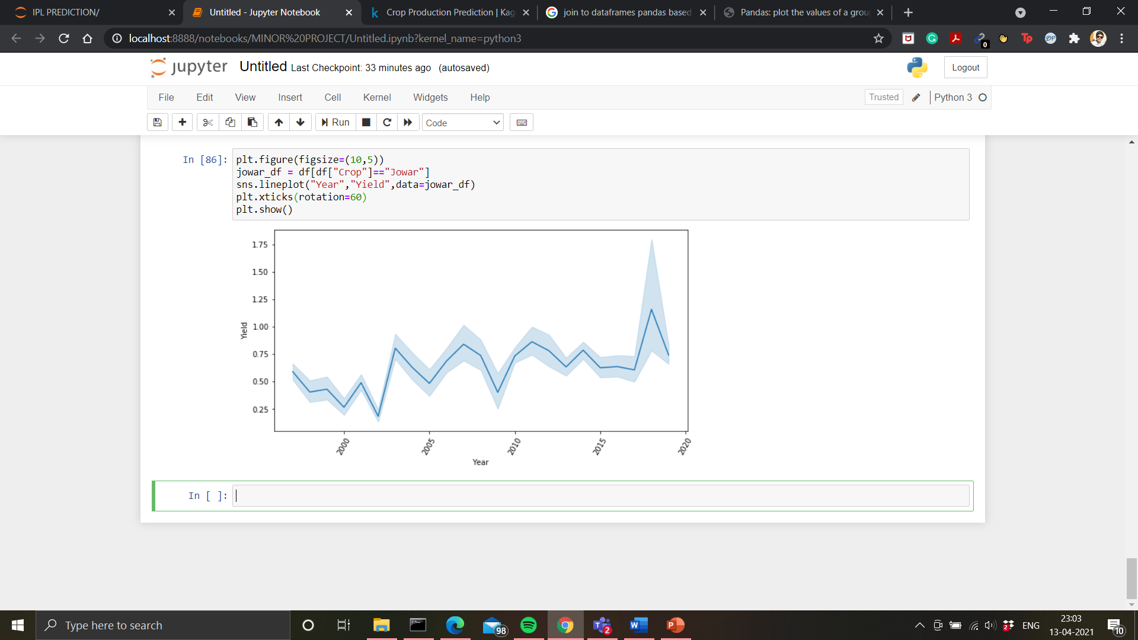
Figure: Area under irrigation vs Year (Jowar)
Figure: Yield vs Year (Jowar)

Slide 22
From our analysis, we can infer that even though there hasn’t been a set rainfall pattern over the years, the production of each crop has steadily increased, barring Wheat and Jowar from the years 2016-2019 wherein we can definitely see a sharp decrease in the rainfall patterns. This indicates us towards the rise in dependency on modern irrigation techniques for most crops, while widely water-consuming crops such as Wheat and Jowar still need assistance from natural water sources, i.e., mainly the rain.
It can also be concluded that area under irrigation has remained pretty much constant over the years, which tells us that area being a very limited resource can not be increased since land is required for several other purposes. But due to the increase in population, the demand for food grains has also been constantly increasing. In order to meet these demands, production needs to be increased, which has been the case over the years. Since the area hasn’t altered much for most crops, the rise in the yield tells us that the modern methods of irrigation and production and the use of better fertilizers and other modernized methods has resulted in a better yield of these particular crops.

Slide 23
5. Models and Performance
Explaining the models used and their results obtained.

Slide 24
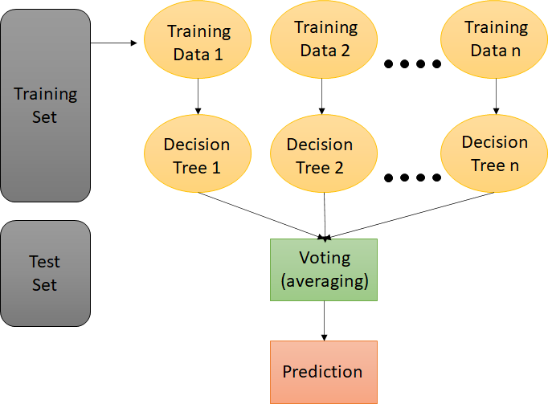
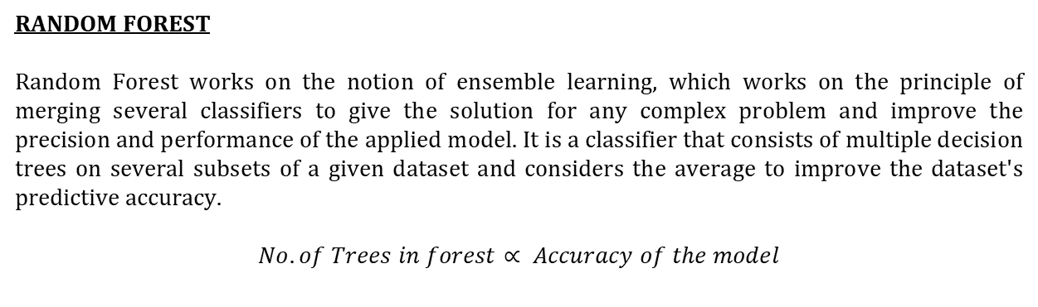
RANDOM FOREST
Random Forest works on the notion of ensemble learning, which works on the principle of merging several classifiers to give the solution for any complex problem and improve the precision and performance of the applied model. It is a classifier that consists of multiple decision trees on several subsets of a given dataset and considers the average to improve the dataset's predictive accuracy.
$$No. of Trees in forest∝ Accuracy of the model$$

Slide 25
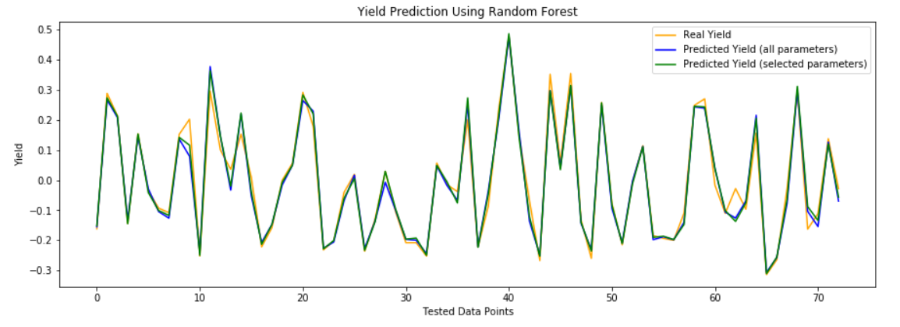
Figure: Model performance of Random Forest.
Parameters | R2 Score | RMSE | MAE
Selected Parameters | 0.9706 | 0.0321 | 0.0217
All Parameters | 0.9638 | 0.0356 | 0.0251

Slide 26
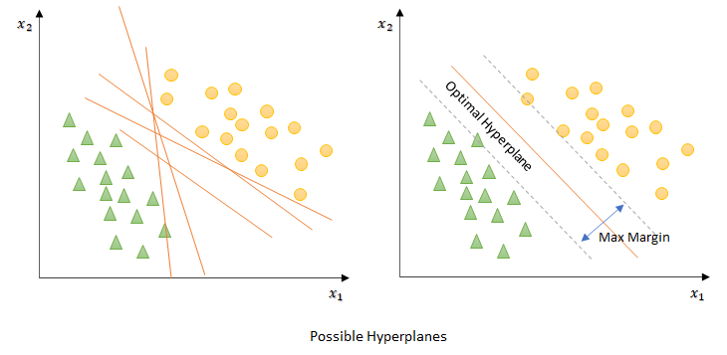
SUPPORT VECTOR MACHINE
The goal of the support vector machine algorithm is to discover a hyperplane in N-dimensional space (N refers to the number of features present in the dataset) that classifies the data points very distinctly. To detach the two classes of information points, there are various possible hyperplanes that could be chosen. We will likely find a plane that has the best edge, i.e., the highest distance between data points of the two classes we are dissecting. Extending the edge distance gives some help so future data points can be organized with more assurance.

Slide 27
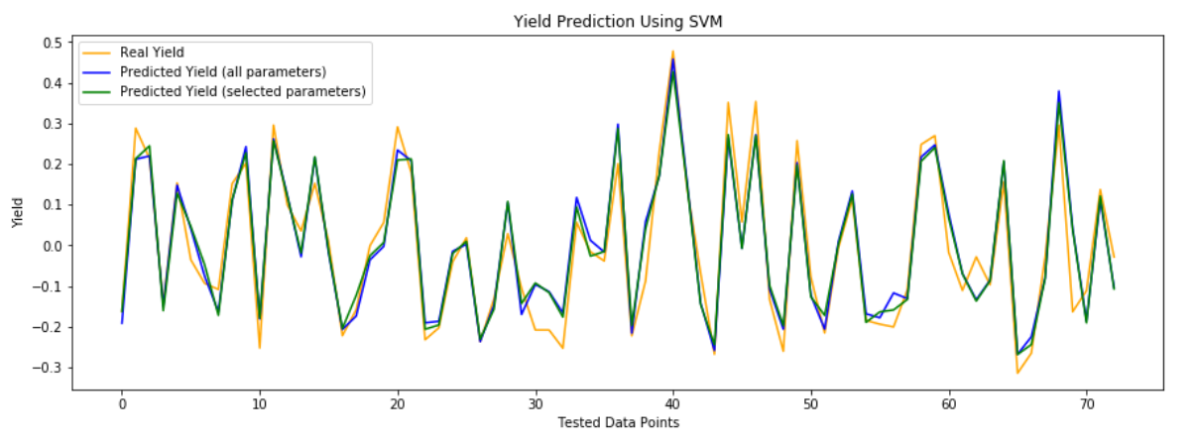
Figure: Model performance of Support Vector Machine.
Parameters | R2 Score | RMSE | MAE
Selected Parameters | 0.9033 | 0.0582 | 0.0474
All Parameters | 0.8982 | 0.0597 | 0.0478

Slide 28
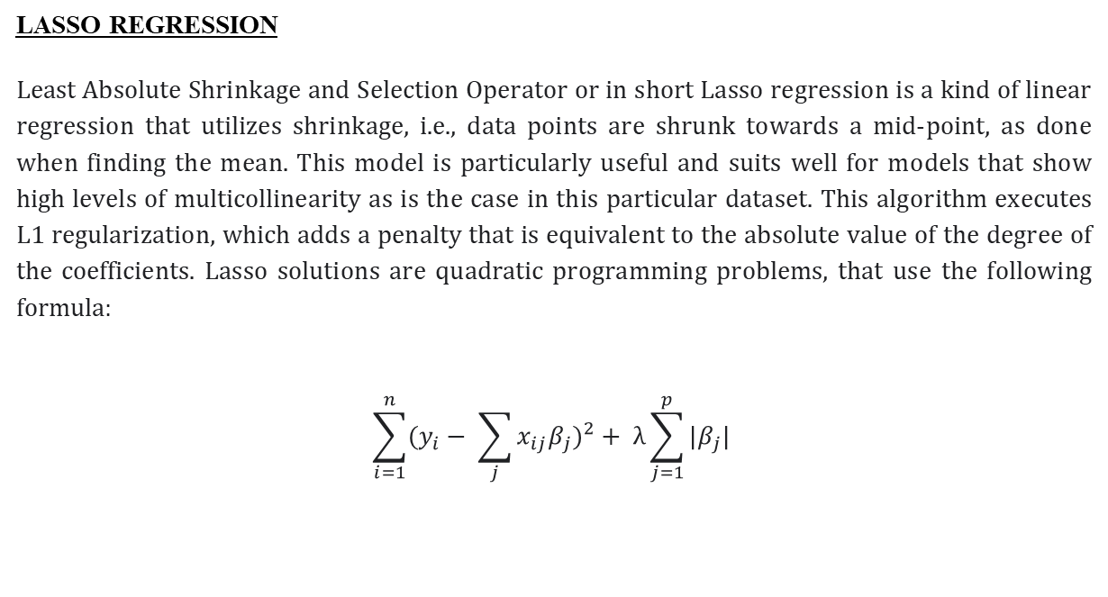
LASSO REGRESSION
Least Absolute Shrinkage and Selection Operator or in short Lasso regression is a kind of linear regression that utilizes shrinkage, i.e., data points are shrunk towards a mid-point, as done when finding the mean. This model is particularly useful and suits well for models that show high levels of multicollinearity as is the case in this particular dataset. This algorithm executes L1 regularization, which adds a penalty that is equivalent to the absolute value of the degree of the coefficients. Lasso solutions are quadratic programming problems, that use the following formula:
$$\sum_{i=1}^{n}{(y_{i}− \sum_{j}{x_{ij}β_{j})^{2}+ λ\sum_{j=1}^{p}{|β_{j}|} }}$$

Slide 29
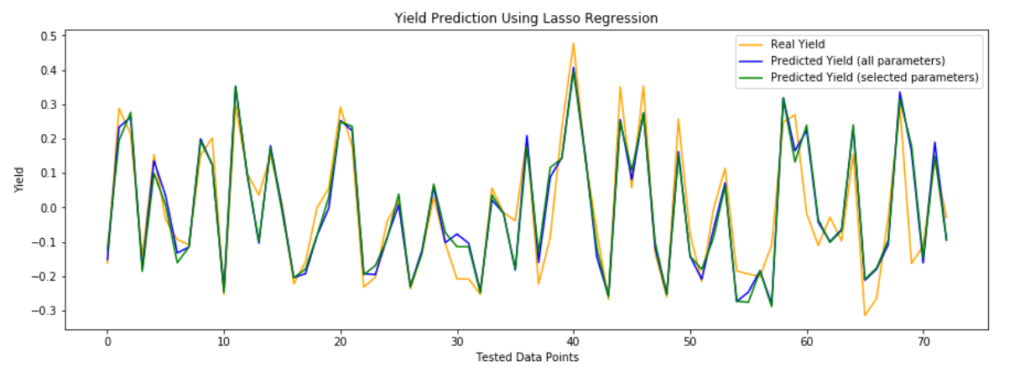
Figure: Model performance of Lasso Regression.
Parameters | R2 Score | RMSE | MAE
Selected Parameters | 0.7929 | 0.0853 | 0.0627
All Parameters | 0.8146 | 0.0806 | 0.0588

Slide 30
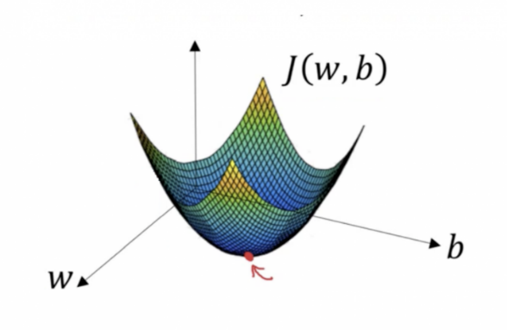
GRADIENT DESCENT
Gradient Descent finds the coefficients that minimize the cost function as far as possible by identifying a local minimum of the differentiable function. It begins by characterizing the initial parameter values and then uses analytics and calculus to iteratively change the values so that they limit the given cost function. Gradient descent can also be defined as the slope of any given function. The greater the gradient, the greater the slope, and thus the faster the model's learning rate. When the slope reaches zero, the model stops learning. As a result, we can argue that a gradient is simply the partial derivate with regard to the introduced values.

Slide 31
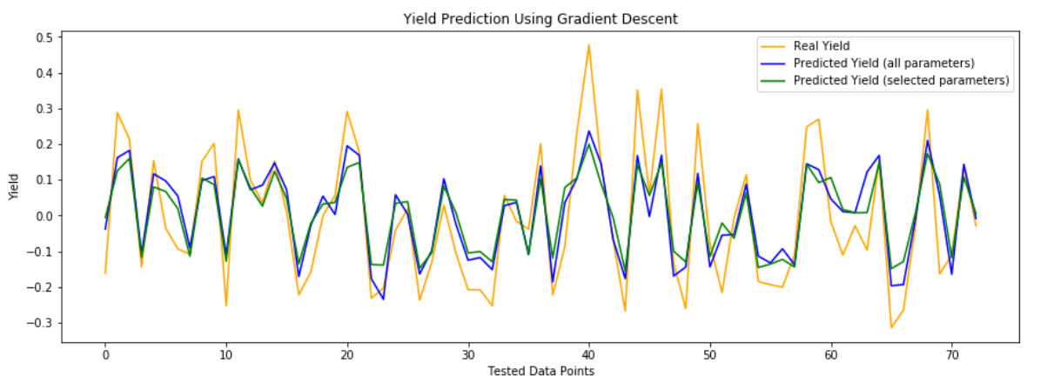
Figure: Model performance of Gradient Descent.
Parameters | R2 Score | RMSE | MAE
Selected Parameters | 0.6721 | 0.1073 | 0.0883
All Parameters | 0.7373 | 0.0960 | 0.0790

Slide 32
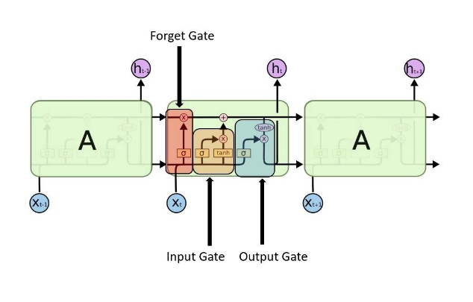
LONG SHORT TERM MEMORY (LSTM)
Long short-term memory (LSTM) is a type of recurrent neural network (RNN) that is capable of long-term dependence. RNN is simply a generalized feedforward neural network with internal memory. RNN is recurrent in nature, as the name implies, and so performs the exact function for all data inputs, although the output of the current input is significantly dependent on prior calculations. Unlike other standard feedforward neural organizations, LSTM has feedback connections. It cannot only cycle single information points that are the particular data points. Such a network is used to process and predict problems involving time series and other complex problems such as this one. LSTM, being a modification of RNN, helps resolve one of the major problems faced on any RNN network, which is the vanishing gradient problem.

Slide 33
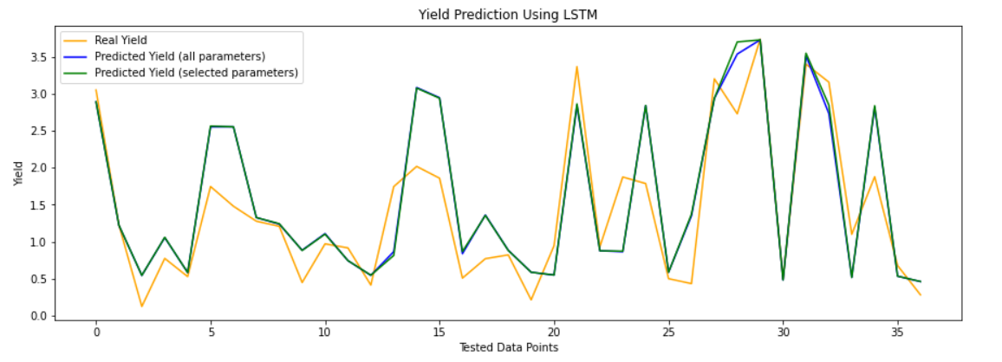
Figure: Model performance of LSTM.
Parameters | R2 Score | RMSE | MAE
Selected Parameters | 0.7605 | 0.4989 | 0.4128
All Parameters | 0.7578 | 0.5018 | 0.4164

Slide 34
PERFORMANCE COMPARISON
MODELS | R2 SCORE | RMSE | MAE
RANDOM FOREST | 0.9706683562457551 | 0.03210438555877871 | 0.02171092742447838
SVM | 0.9033044480088029 | 0.0582907187068775 | 0.04744273781182322
LASSO REGRESSION | 0.7929212370102475 | 0.08530292881366584 | 0.06279053471454211
GRADIENT DESCENT | 0.6721446803333357 | 0.10733399123627024 | 0.08833348922241419
LSTM | 0.7605970571904346 | 0.4989149684766394 | 0.4128063470375437
Table: Model performance using only area and production as parameters
MODELS | R2 SCORE | RMSE | MAE
RANDOM FOREST | 0.9638436515081396 | 0.03564416484020771 | 0.025122868659073126
SVM | 0.8982433161230687 | 0.059796757425198625 | 0.047852253033345137
LASSO REGRESSION | 0.8146824212217434 | 0.08069645755381685 | 0.0588093331954562
GRADIENT DESCENT | 0.737347767385024 | 0.09606976093705671 | 0.07906984158002965
LSTM | 0.75781934584411 | 0.50180099201939 | 0.4164927767185484
Table: Model performance using all parameters

Slide 35
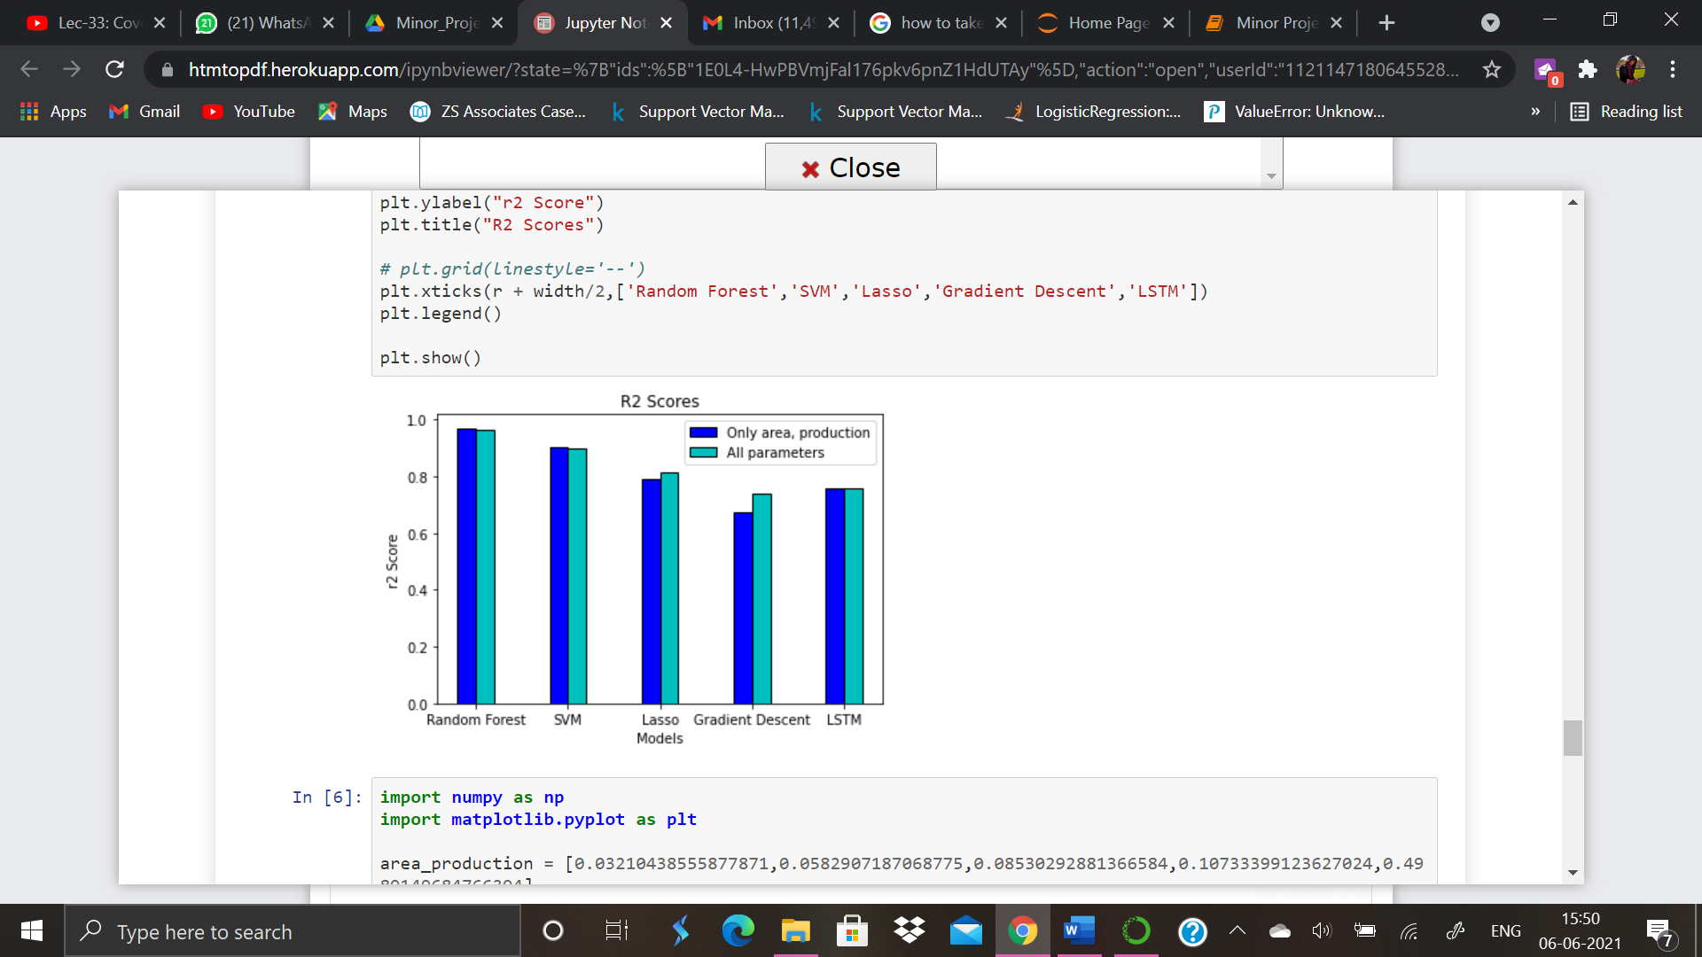
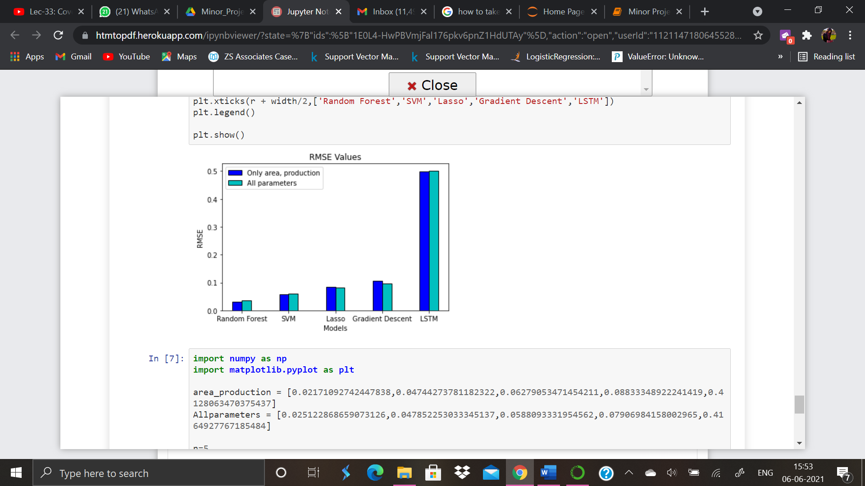
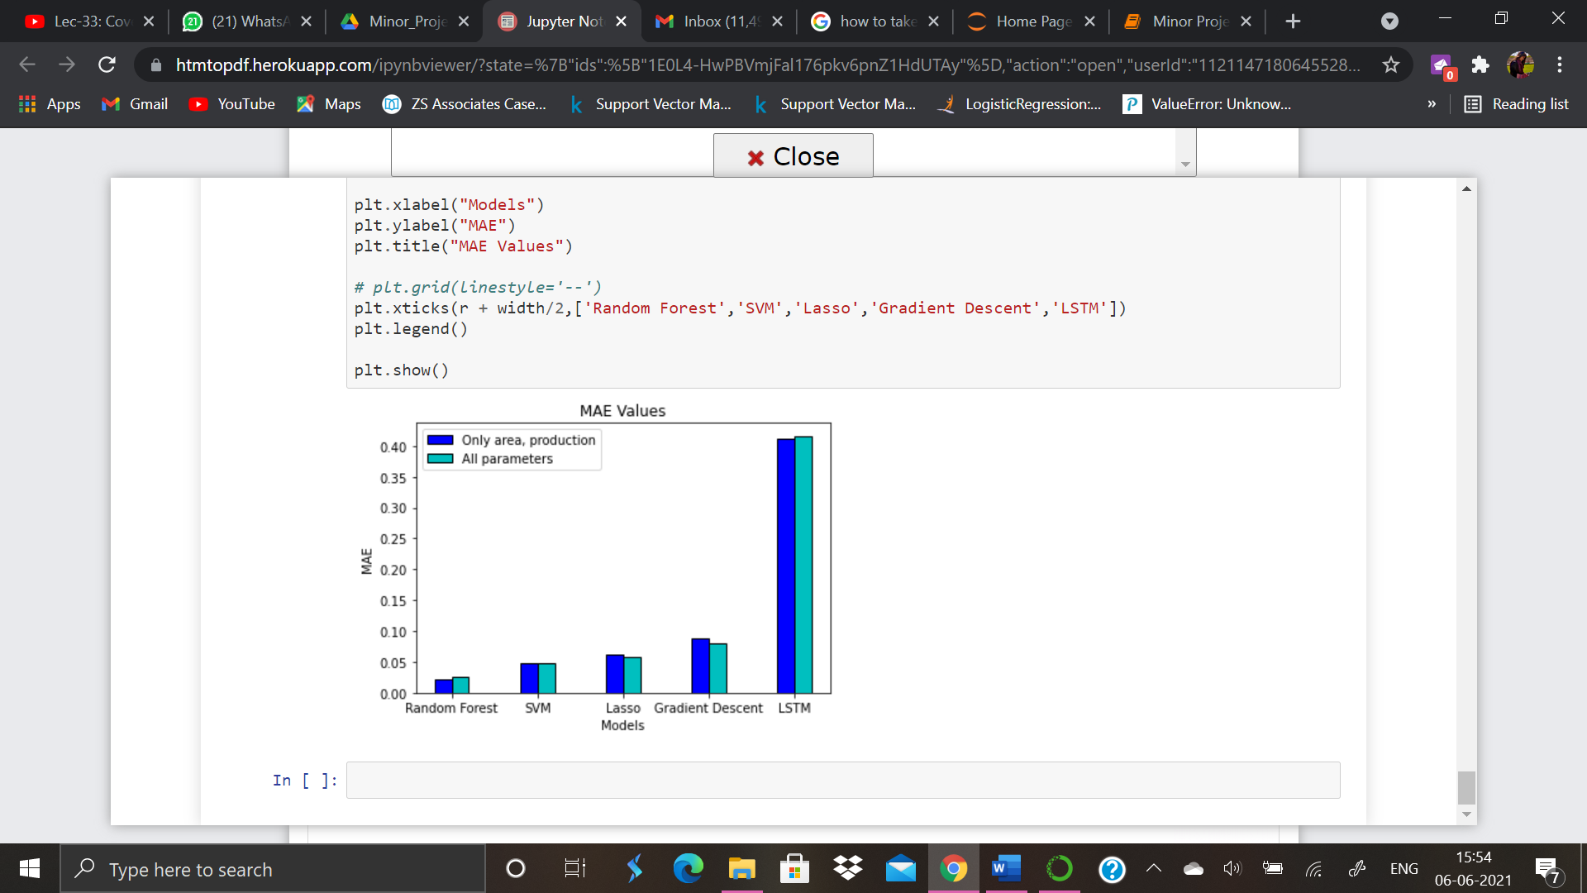
Figure: R2 Score values comparison
Figure: RMSE values comparison
Figure: MAE values comparison

Slide 36
6. Result Analysis
Analyzing the achieved results.

Slide 37
On observation, we can see that most of our models have almost similar accuracy in the case of both types of datasets. Mostly, the accuracy of most of our models decreases on the addition of the scientific parameters of soil and mean rainfall, but in models such as Lasso Regression and Gradient Descent we observe the contrary.
Although our LSTM model shows a higher R² score when compared to the Gradient Descent algorithm, its RMSE and MAE values are also very high, which is not a good sign for a predictive model.

Slide 38
7. Conclusion
Learnings from our project.

Slide 39
In the end we concluded that the machine learning models that we have applied, that are – Random Forest, Support Vector Machine (SVM) and Lasso Regression – when compared to the deep learning models – Gradient Descent and Long Short Term Memory (LSTM) – give a better and more accurate result. This might be because models like LSTM require a bigger quantum of data for a better predictional analysis when compared to other models.
Most of our models perform better on the specified parameters, whereas models such as Gradient Descent and Lasso Regression perform better when applied to the dataset with all parameters. While we know that soil type and rainfall are important factors in the production of any crop, we need a more in-depth analysis of these factors as well as a larger database to use in our real-world prediction models.
Random Forest algorithm outperforms all other models.

Slide 40
THANK YOU!

